Slide 1
APPLE STOCK FORECAST
Team 5

Slide 2
Mentor : Ms. Neha Gupta
Project kick off date : 10/11/2022
Team Members
Mr. VIPIN K C
Mr. ANIRUDH C A
Mr. PAVAN KUMAR M
Mr. CHIMALA RAJESH
Miss. EZHILMATHI ARIVEZHIL
Miss. AISHWARYA KODOTH

Slide 3
Table of Contents
Defining Business Problem ,Scope and Objective
Dataset Details
Data pre-processing
EDA/Data visualization
Model building
Project Summary
Model deployment

Slide 4
Business Objective:
Generate, analyze and process the features from the dataset and use them to predict the apple stock market price for the next 30 days.

Slide 5
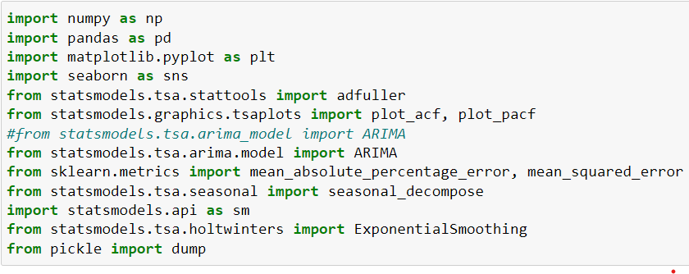
Importing Libraries & Datasets :

Slide 6

Dataset details:
There are Open, High, Low and Close price has been given for each day starting from 2012 to 2019 for Apple stock.
Date : Date of trading
Open : Price at which security first trades
High : Highest Price of the trading day
Low : Lowest Price of the trading day
Close : Last Price the stock traded during the trading day
Adj Close : Price that is adjusts Coroporate Actions on Closing price
Volume : Number of Shares that changed hands during the trading day

Slide 7
Data Cleaning and Pre-Processing
Dataset has no null values and no duplicated values.
Converted date column into datetime format and set date column as index.
Multicollinearity between features identified.
Selected Close price as target variable.

Slide 8
Exploratory Data Analysis
Exploratory Data Analysis (EDA) is an approach to analyze the data using visual techniques. It is used to discover trends, patterns, or to check assumptions with the help of statistical summary and graphical representations.
Data visualization
Data Visualization is the process of analyzing data in the form of graphs or maps, making it a lot easier to understand the trends or patterns in the data. There are various types of visualizations .

Slide 9
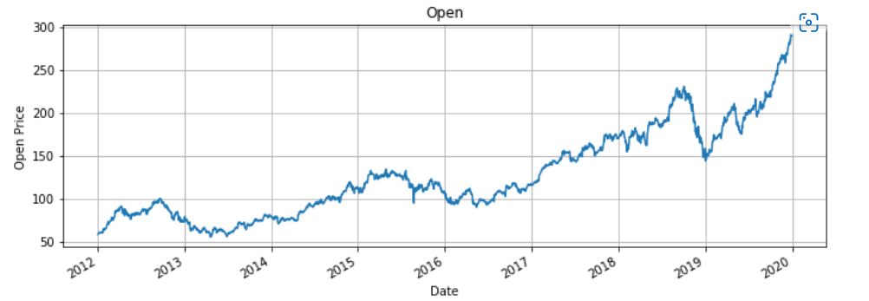
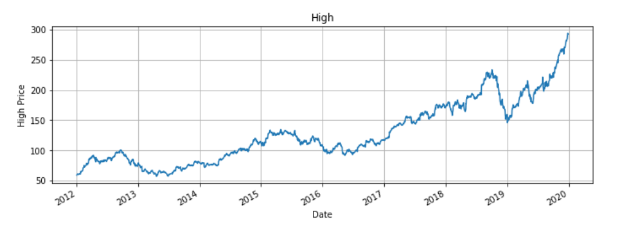
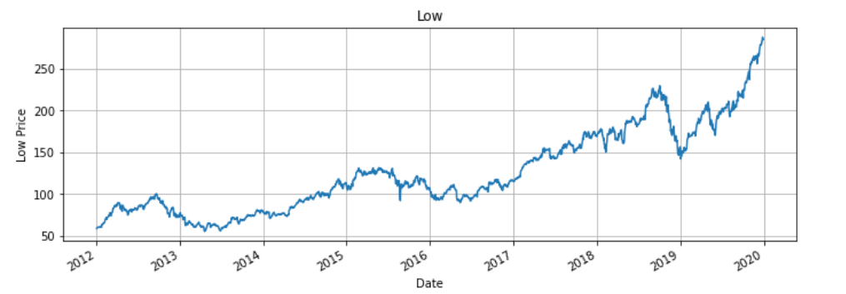
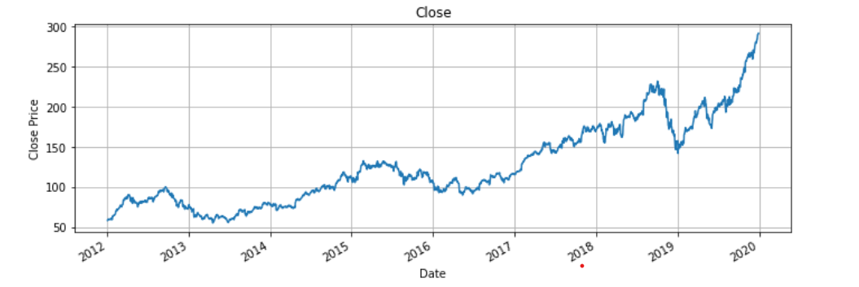
Data Visualization

Slide 10
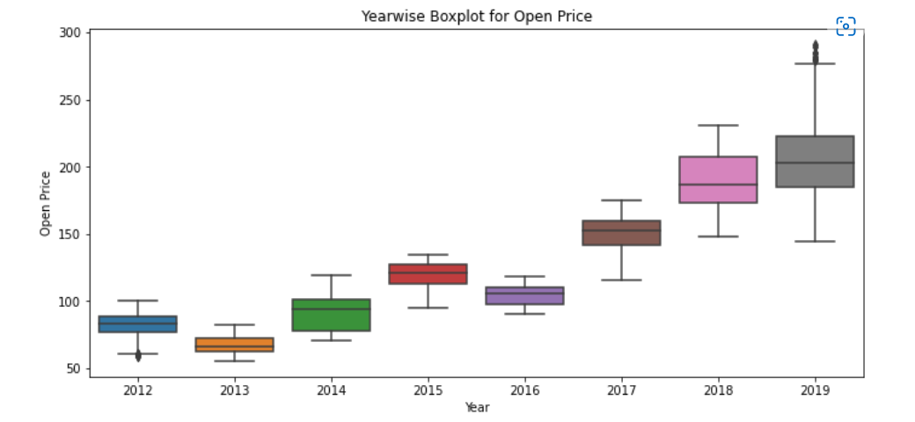
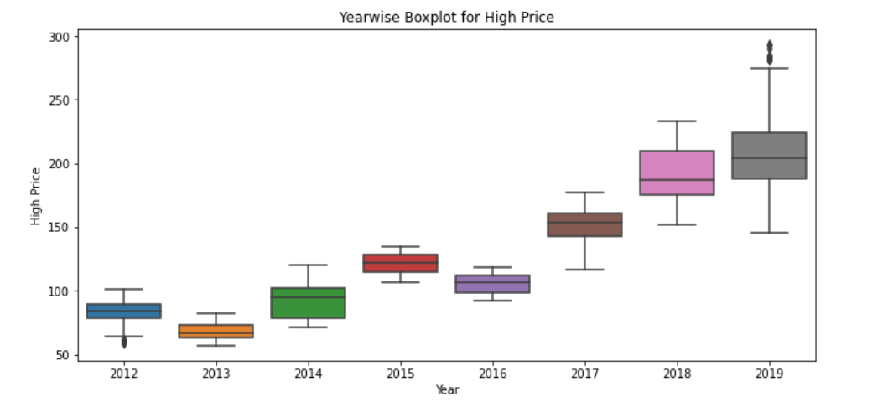
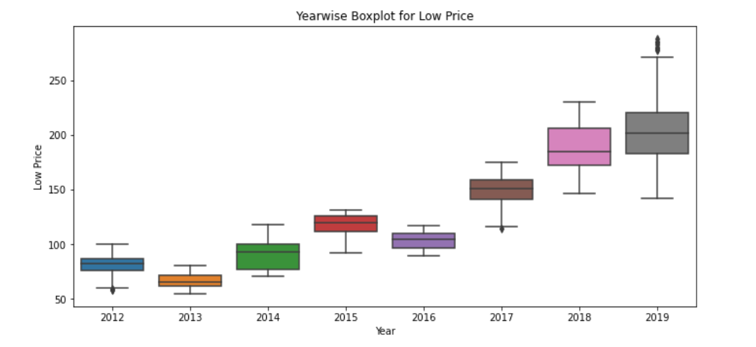
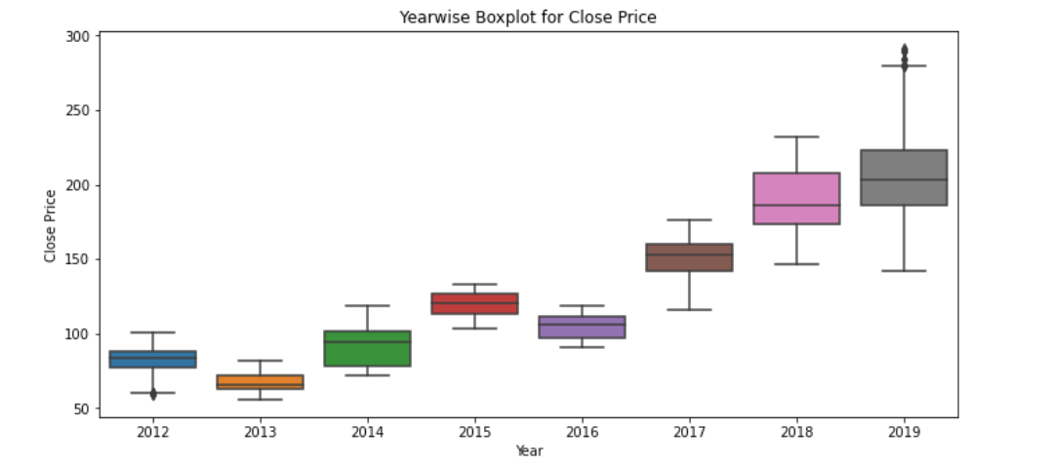
Year-wise Boxplot for each features

Slide 11
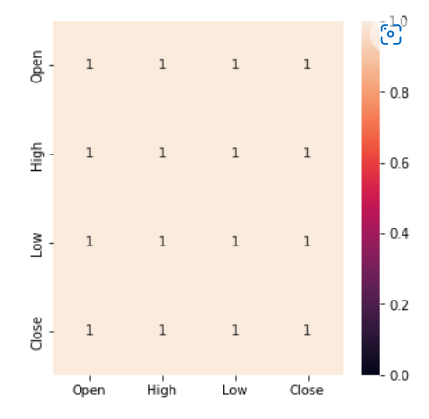
Heat Map
Multicollinearity between features are identified.
Close price is selected as target feature.

Slide 12
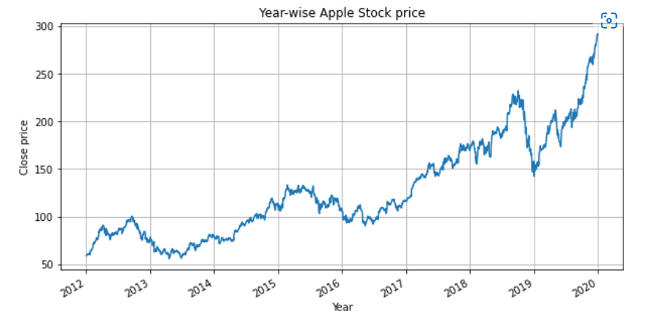
Year-wise Apple stock price
Apple stock price is getting increased each year.
Huge stock price drop in year 2018-19.

Slide 13
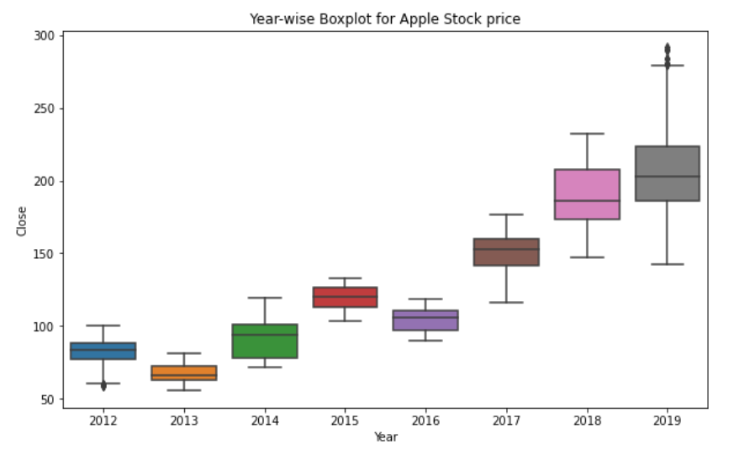
Year-wise Boxplot for Apple Stock Price
Outliers are detected in year 2012 and 2019.
2019 is the most volatile year.

Slide 14
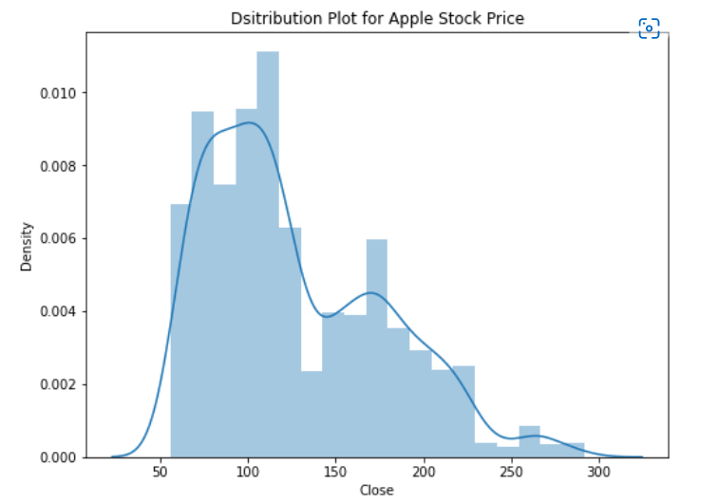
Distribution Plot for Apple Stock Price
Stock price is right skewed.

Slide 15
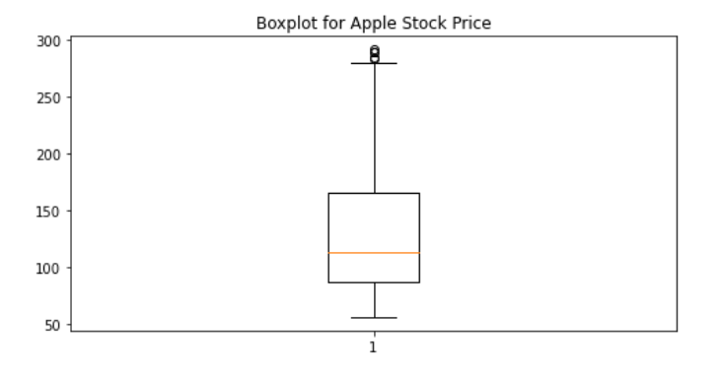
Boxplot for Apple Stock Price
Outliers are detected on dates 2019-12-23, 2019-12-24, 2019-12-26, 2019-12-27 and 2019-12-30.

Slide 16
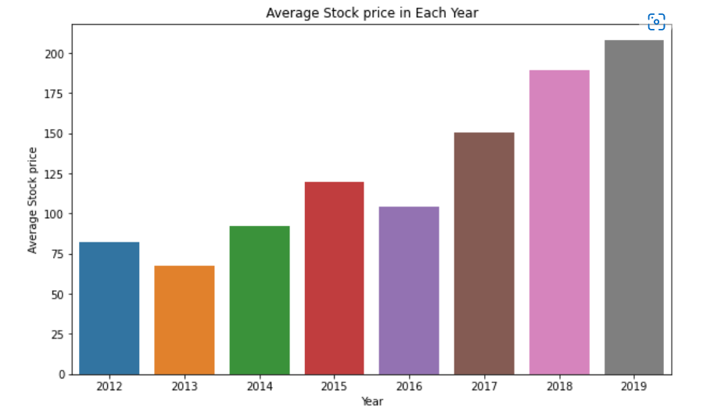
Average stock price in each year
Apple stock price is increasing each year.
In 2013 and 2016 average stock price is lower than previous year.

Slide 17
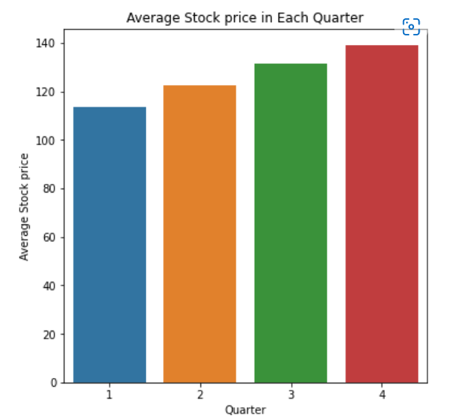
Average stock price in each quarter
Q4 has the highest average stock price

Slide 18
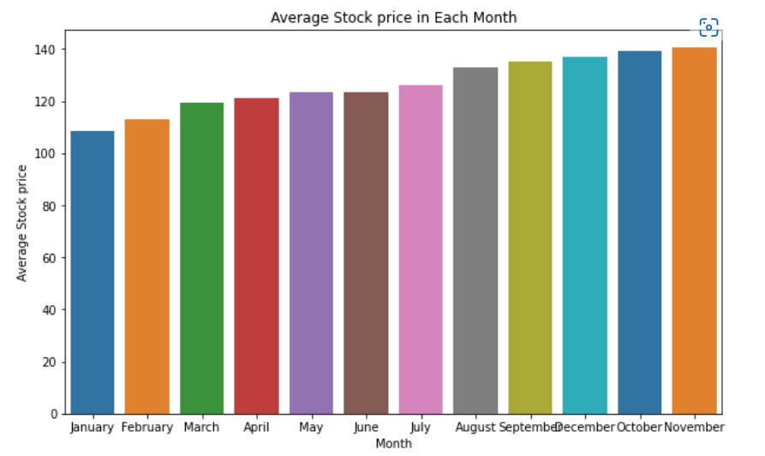
Average stock price each year
Apple stock price is highest in November.

Slide 19
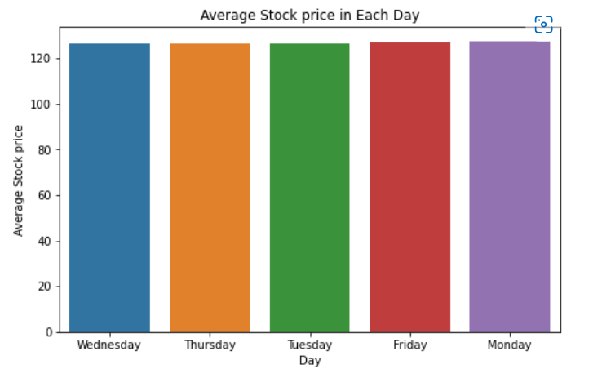
Average stock price in each day
Average stock price are almost same in each day of week.
It is slightly high on Mondays.

Slide 20
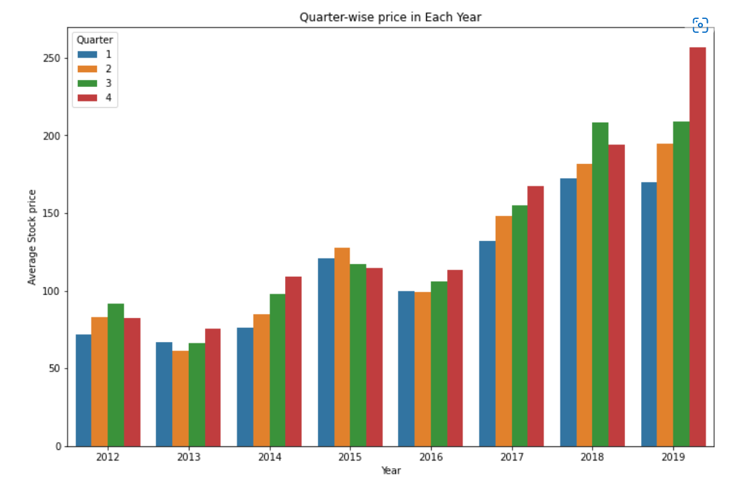
Quarter-wise price in each year
Q4 has the highest average stock price and it is seasonal.

Slide 21
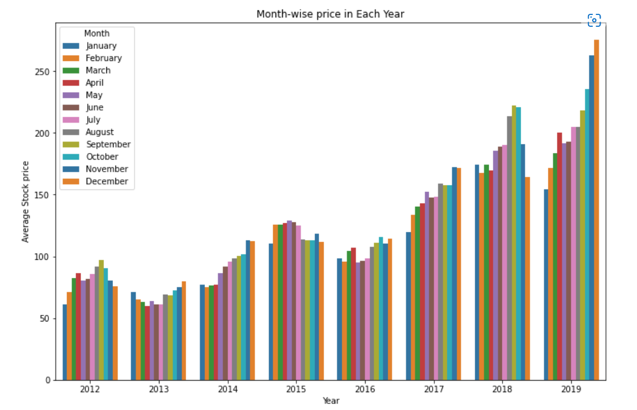
Month-wise price each year
On an average Apple stock price is low at start of the year compared to end of the year.

Slide 22
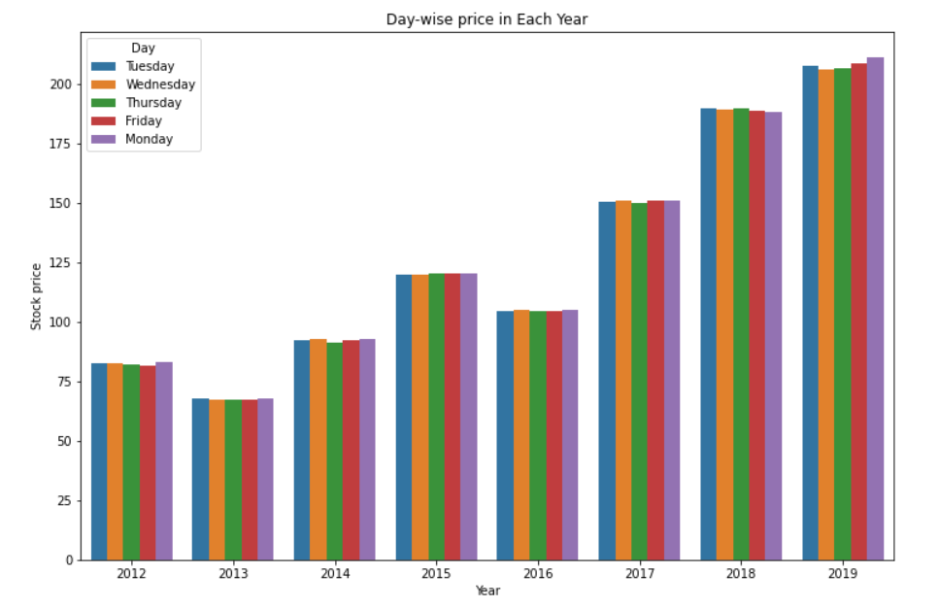
Day-wise price each year

Slide 23
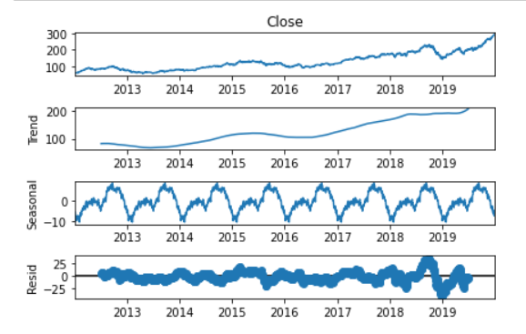
Seasonal Decompose
Time series has upward trend.
Seasonal periods are 251 days.

Slide 24
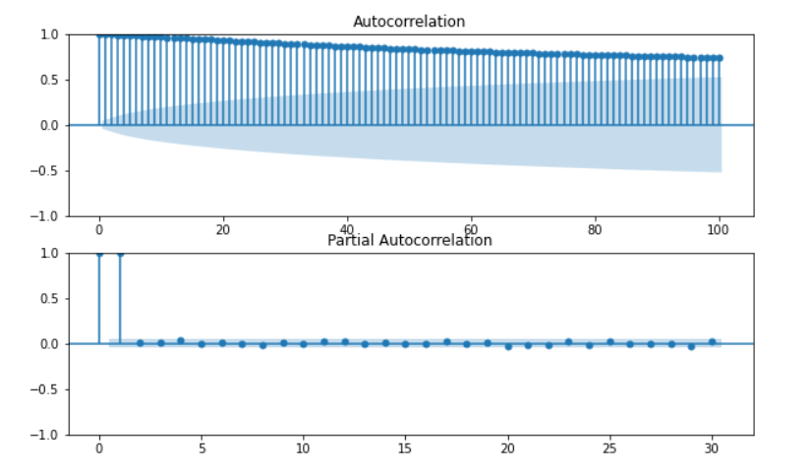
ACF & PACF PLOTS

Slide 25
Insights from EDA
Time series data has trend and seasonality. Trend is upward and seasonal period is 251 days.
The year 2019 is the most volatile year. A huge drop in stock price happened in the same year. The primary reason for this is as investors are worried about iphone sales since the sales figures of iphone's new line-up wasn't that good compared to previous.
https://www.bbc.com/news/business-46281768
Q4 is the best quarter for Apple according to average stock price. This is because the new product cycle takes place in this period. We also observe this as a seasonal effect for Apple stock.

Slide 26
Model Building
A machine learning model is a file that has been trained to recognize certain types of patterns. You train a model over a set of data, providing it an algorithm that it can use to reason over and learn from those data. Once you have trained the model, you can use it to reason over data that it hasn't seen before, and make predictions about those data.
ARIMA Model
The ARIMA model predicts a given time series based on its own past values. It can be used for any non-seasonal series of numbers that exhibits patterns and is not a series of random events.
Components of ARIMA Model
AR: Autoregression. A model that uses the dependent relationship between an observation and some number of lagged observations. p is the of the AR term.

Slide 27
Holt-Winters Method
I: Integrated. The use of differencing of raw observations in order to make the time series stationary.
MA: Moving Average. A model that uses the dependency between an observation and a residual error from a moving average model applied to lagged observations. q is the order of the MA term.
SARIMA Model
SARIMA Model are nothing but ARIMA Model with seasonality. SARIMA uses seasonal differencing instead of regular differencing. Model will be represented as SARIMA (p,d,q)x(P,D,Q,X), where, P, D and Q are SAR, order of seasonal differencing and SMA terms respectively and ’X' is the frequency of the time series.
Holt-Winters is a model of time series behavior. Holt-Winters is a method to model three aspects of the time series: a typical value (average), a slope (trend) over time, and a cyclical repeating pattern (seasonality).

Slide 28
Augmented Dickey–Fuller Test
The Augmented Dickey-Fuller Test is used to determine if time-series data is stationary or not. Similar to a t-test, we set a significance level before the test and make conclusions on the hypothesis based on the resulting p-value.
Null Hypothesis: The data is not stationary.
Alternative Hypothesis: The data is stationary.
Here we fail to reject H₀ since the p value is greater than significant value.
Therefore Time series is non-stationary.
So we difference series to make it stationary.

Slide 29
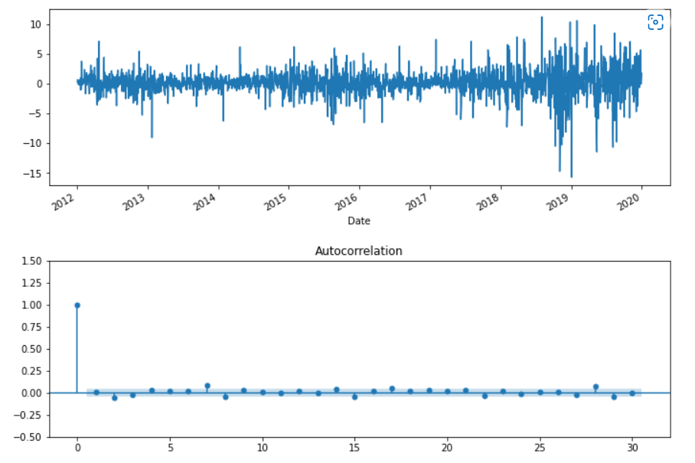
Plot after first order differencing
After first order differencing p-value for Augmented Dickey-Fuller Test is less than significant value. Therefore series became stationary.
Order of differencing is 1.

Slide 30
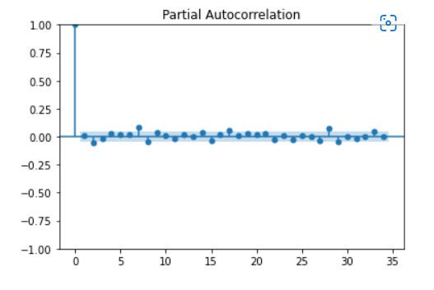
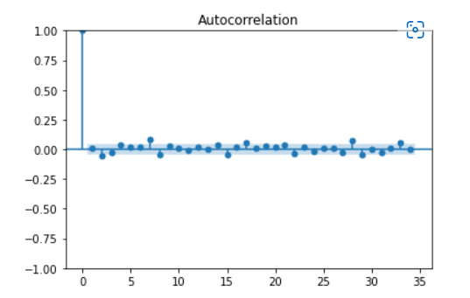
Order of AR(p) and MA(q) term

Slide 31
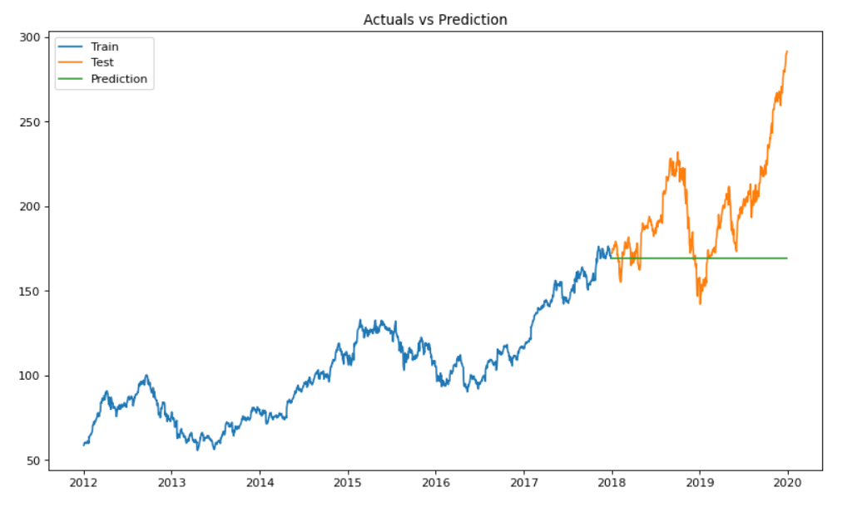
Prediction Based on ARIMA(2,1,0)
From the above plot it is clear that ARIMA model is not performing well.

Slide 32
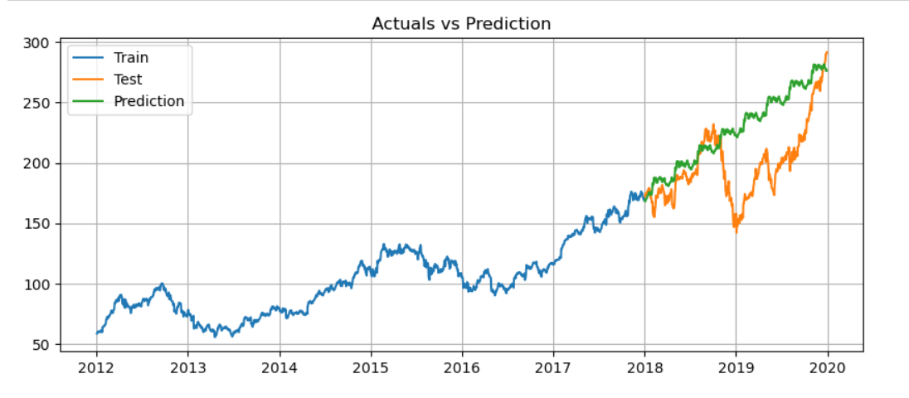
Prediction based on SARIMA(2,1,0)x(1,1,0,63)
SARIMA model is capturing trend and seasonality better than ARIMA and is performing well.

Slide 33
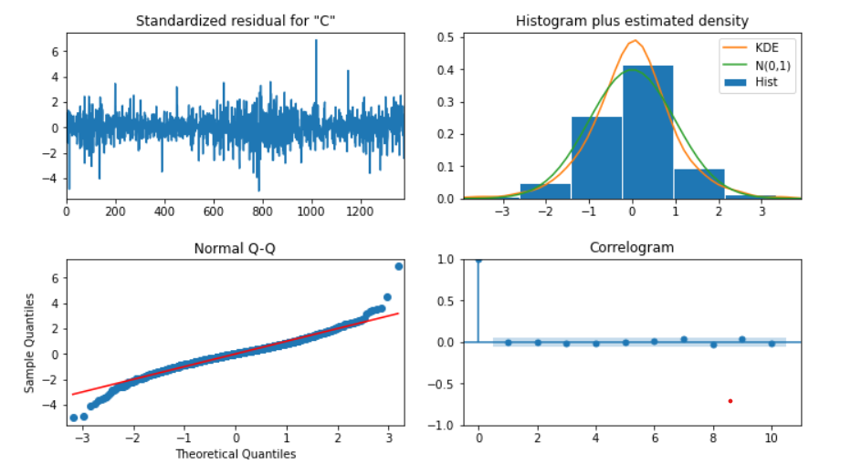
Residual Plot
The residuals are normally distributed with mean 0 and constant variance

Slide 34
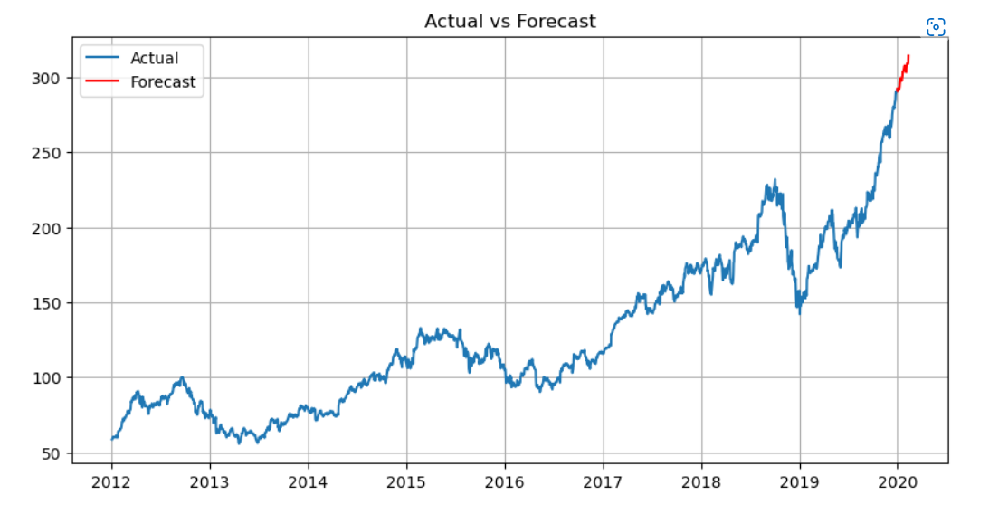
Forecasting based on SARIMA (2,1,0)x(1,1,0,63)

Slide 35
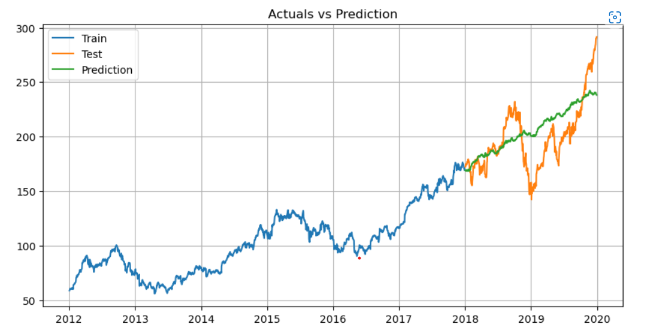
Prediction based on Holt-Winters Method

Slide 36
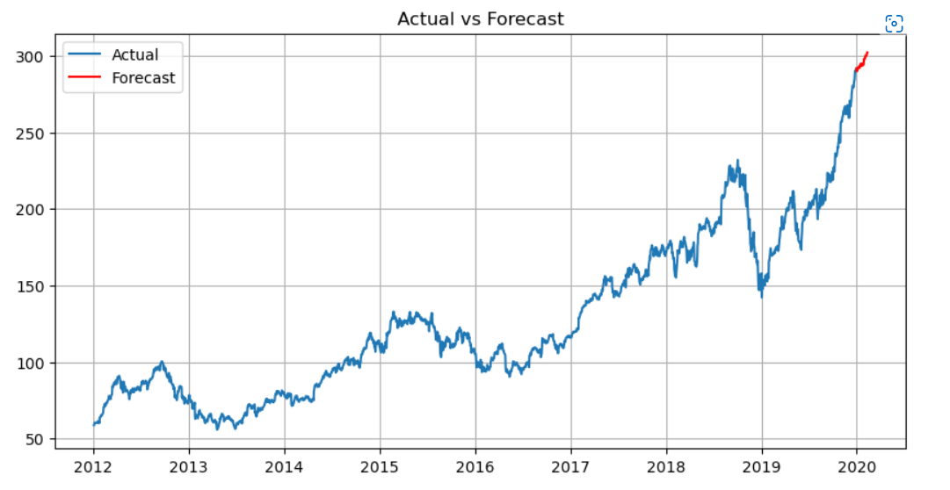
Forecasting based on Holt-Winters method

Slide 37
Accuracy Metrics
Model | RMSE | MAPE | AIC
ARIMA | 41.69 | 0.186 | 5593.170
SARIMA | 39.34 | 0.133 | 5637.928
Holt-Winters method | 23.51 | 0.1 | 3303.364

Slide 38
Project Summary
We build model using ARIMA, SARIMA and Holt-Winters method.
We are not using ARIMA here, since it's not capturing seasonal part.
Accuracy metrics of Holt-Winters method is the better compared to others, but still SARIMA captures seasonal part better.
SARIMA is better at prediction and it has more parameter, since Holt-winters has only 3.
We deployed the model using SARIMA(2,1,0)x(1,1,0,63).

Slide 39
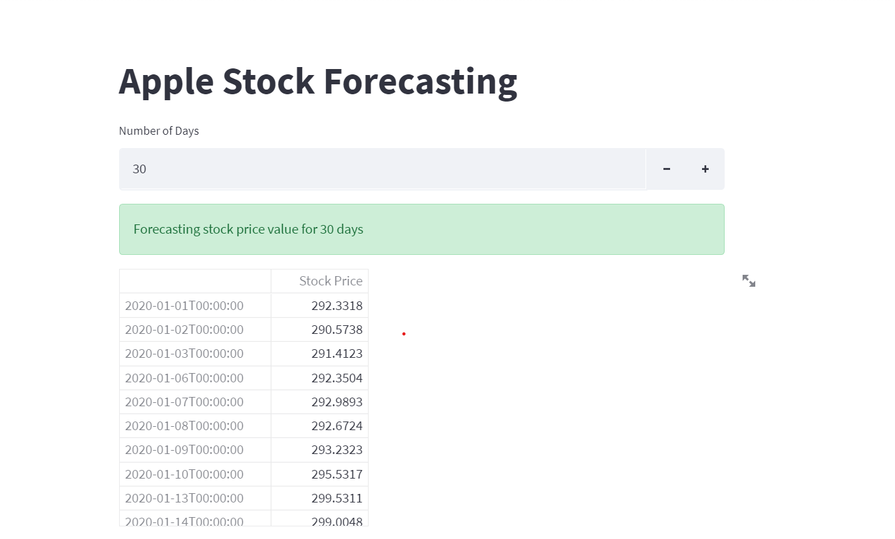
Model Deployment using Streamlit

Slide 40
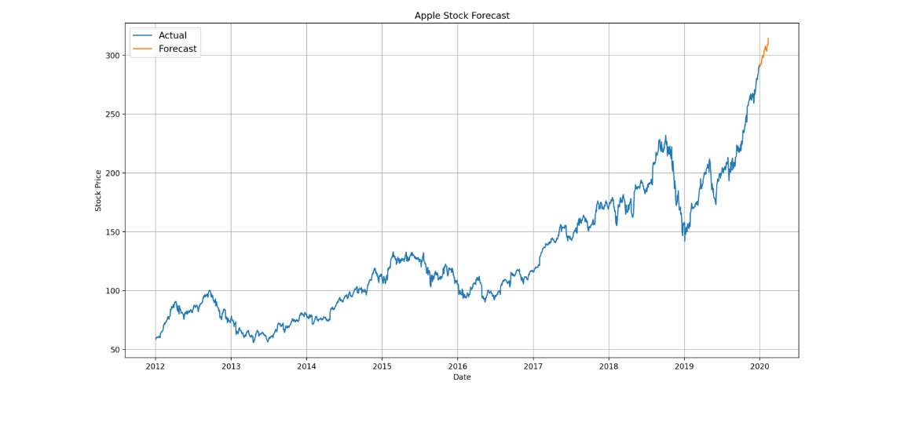

Slide 41
THANK YOU

